Slide 1
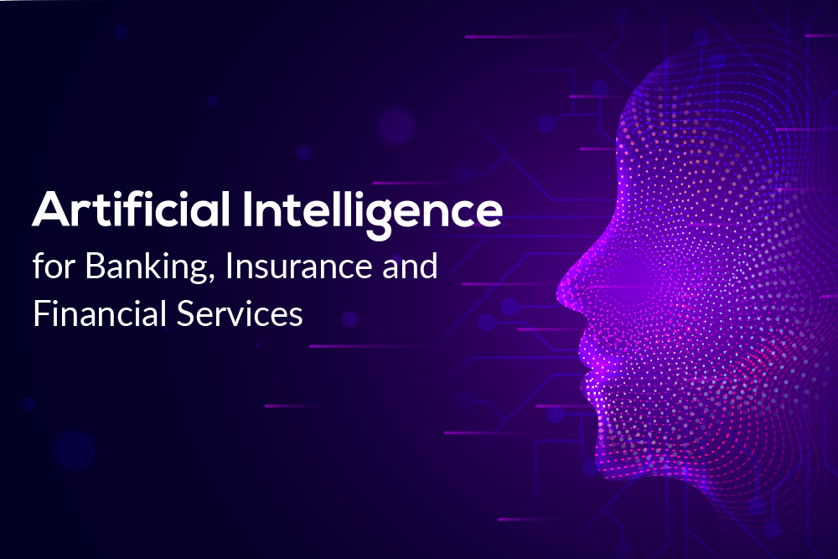
Banking Disclosure using Artificial Intelligence
Team Members:
Anees A
Sreeraj S
Alwin mariya joswa L S
Muthu Sriram M
Sri Praveen S

Slide 2
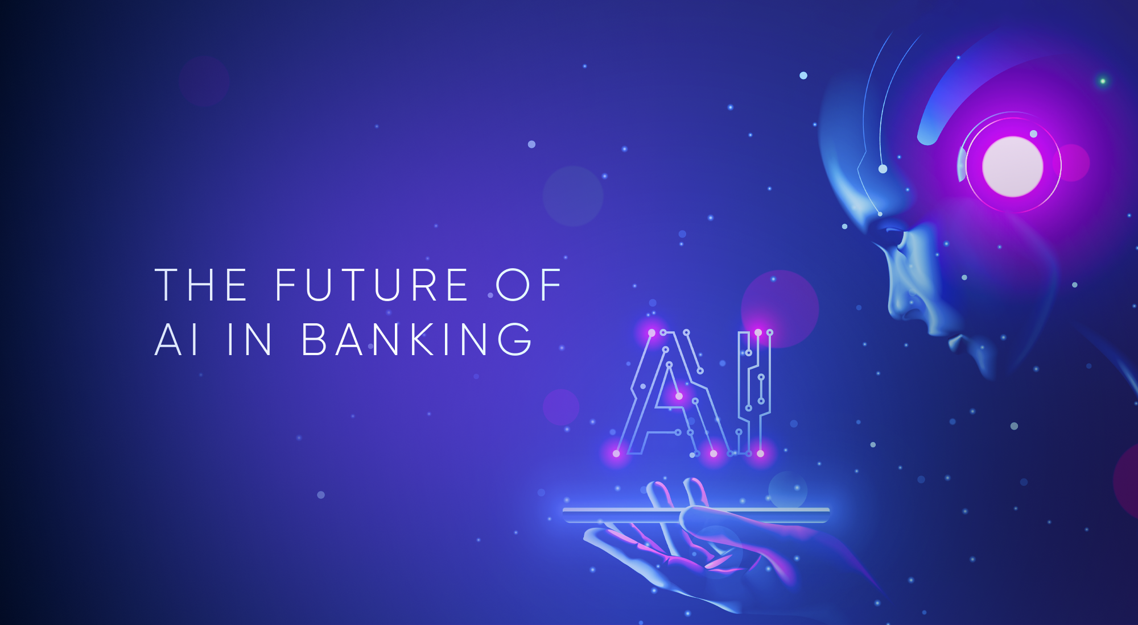



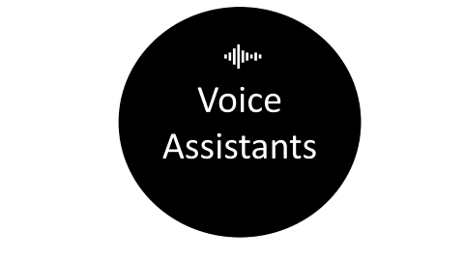

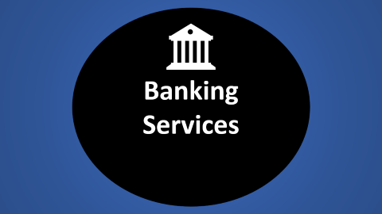


Slide 3

Banking Services

Slide 4
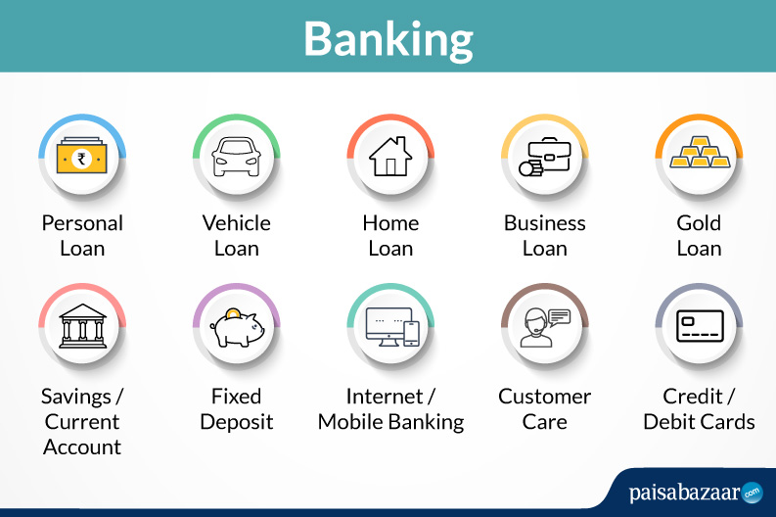
Banking Services

Slide 5

Artificial
Intelligence

Slide 6
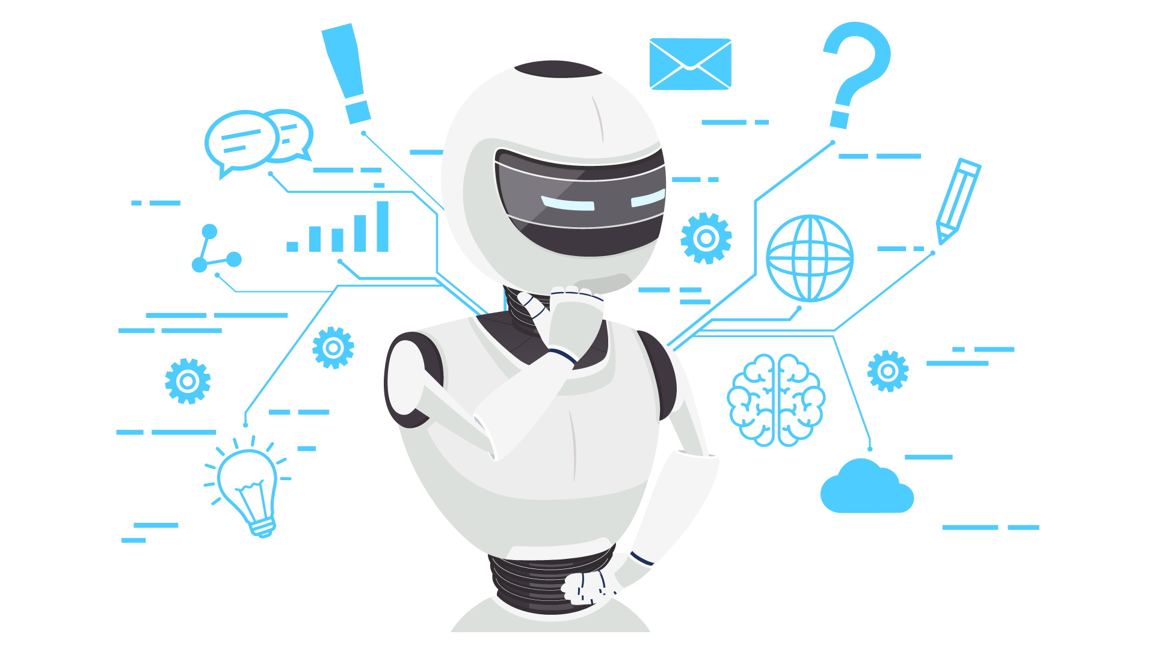
Artificial Intelligence

Slide 7


1:Build Python Code1: Importing Libraries The first step is usually importing the libraries that will be needed in the program. Importing the flask module into the project is mandatory. An object of the Flask class is our WSGI application. Flask constructor takes the name of the current module (_name_).

Slide 8
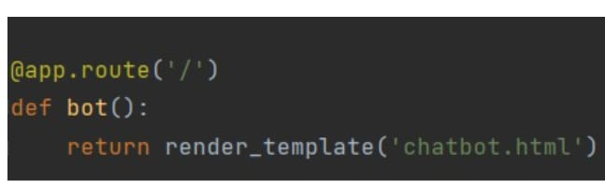
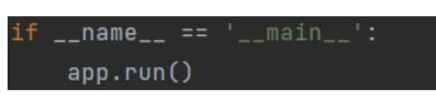
2: Creating our flask application and loading
3: Routing to the Html Page Here, the declared constructor is used to route to the HTML page created earlier. The ‘/’ route is bound with the bot function. Hence, when the home page of a web server is opened in the browser, the HTML page will be rendered . Main Function This is used to run the application in localhost.

Slide 9

Voice Assistants

Slide 10

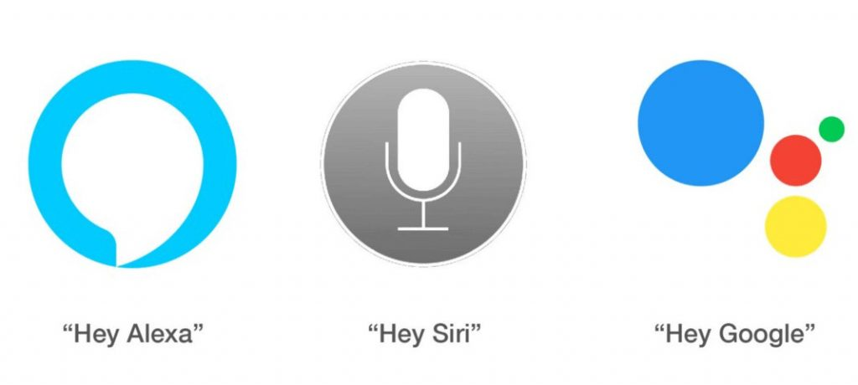
Voice Assistants

Slide 11
In this project, we will be building a chatbot using Watson's assistant. This chat should have the following capabilities : The Bot should be able to guide a customer to create a bank account . The Bot should be able to answer loan queries . The Bot should be able to answer general banking queries . The Bot should be able to answer queries regarding net banking.

Slide 12
Project Objectives After completing this project, you will learn how to Work with Watson Assistant Create Skills in Watson Assistant Use Entities, Intents, Dialogues Deploy skill to generate a preview link. Create IBM Watson Assistant Service Create IBM Watson Assistant Service Click on the catalog and you will be redirected to a page that will show you all the IBM services, from your left pane click on AI and then select Watson Assistant.

Slide 13

Live
Demo

Slide 14


Slide 15
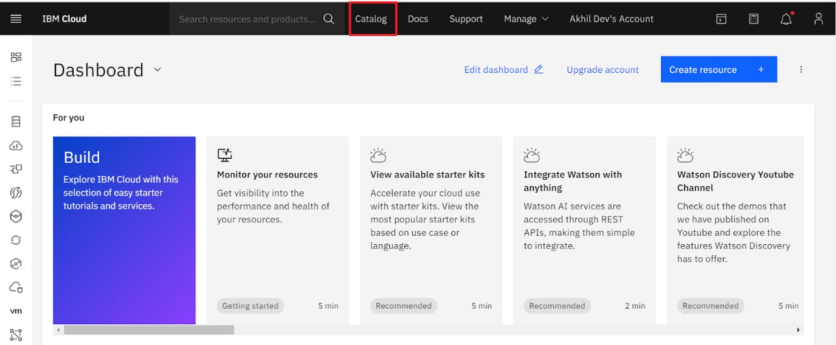

Slide 16
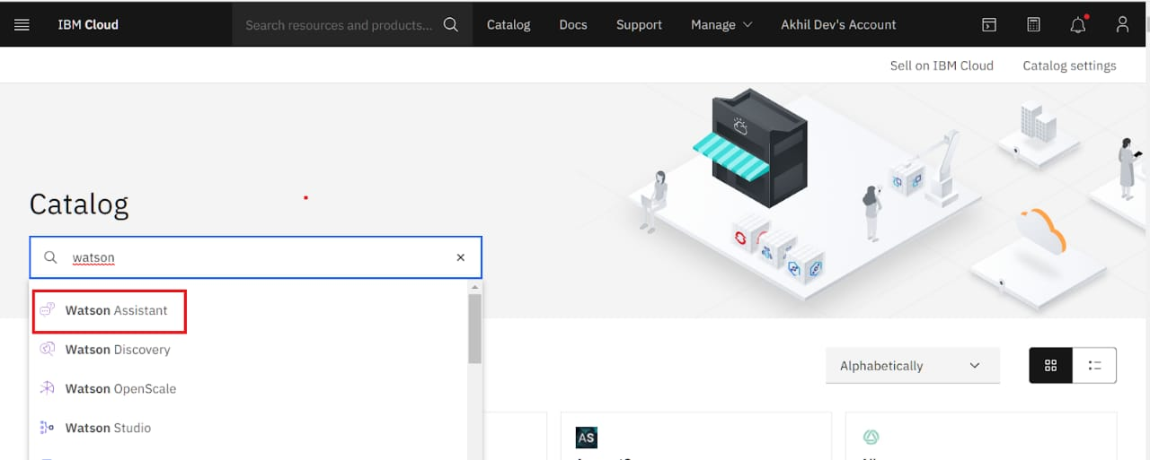

Slide 17
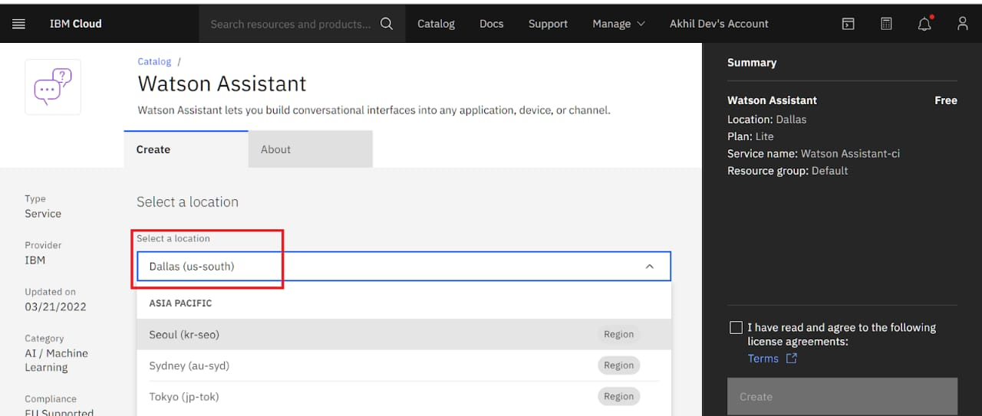

Slide 18
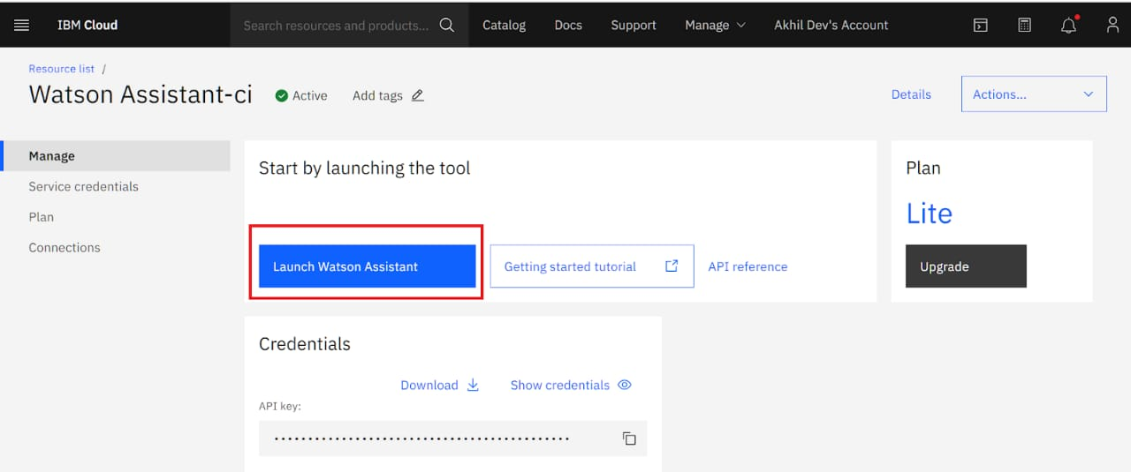

Slide 19
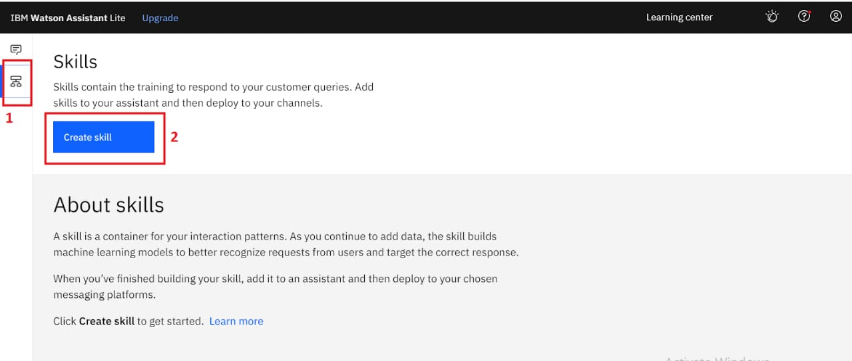

Slide 20
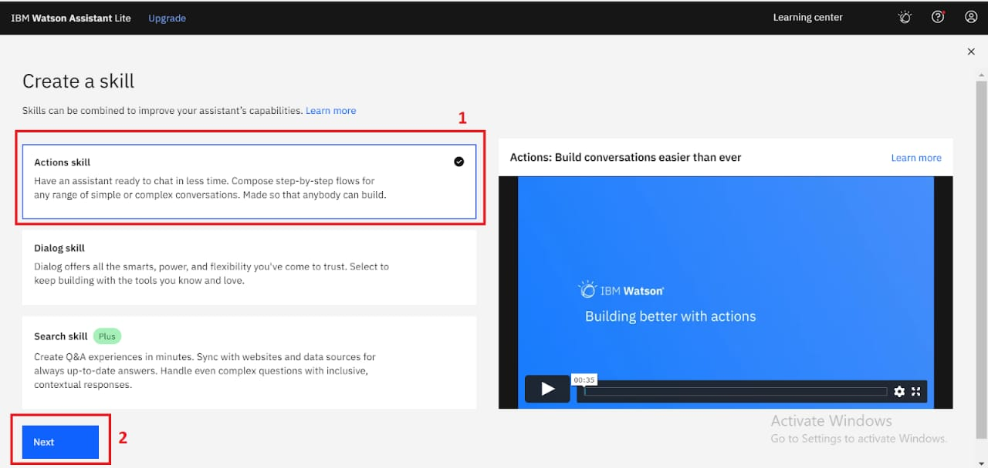

Slide 21
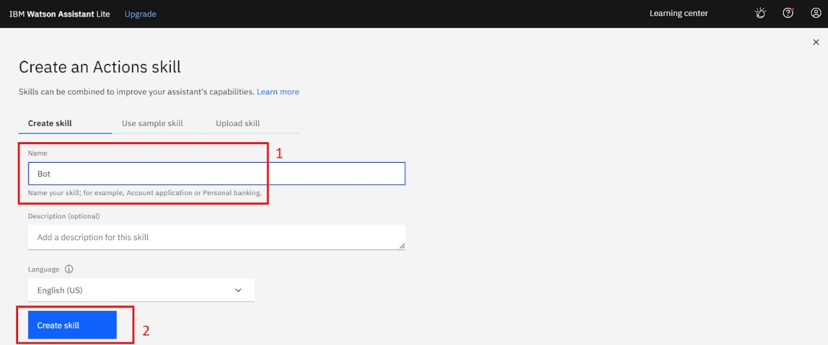

Slide 22
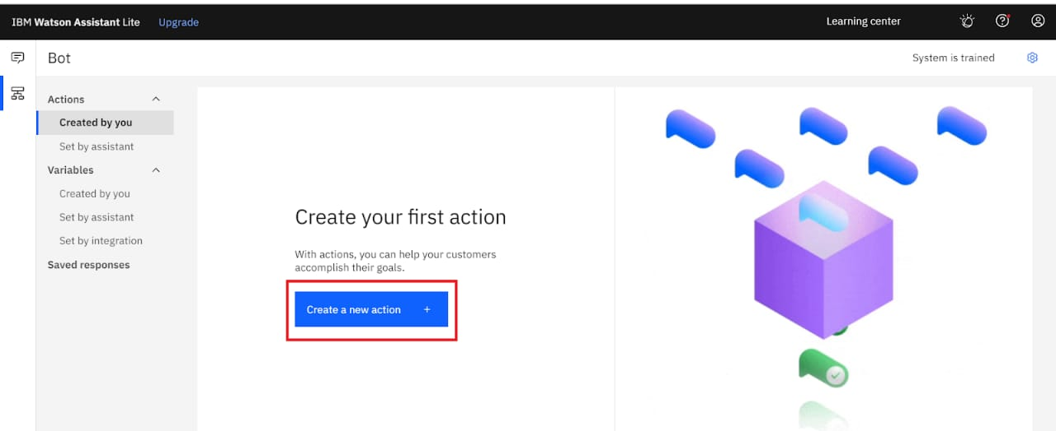

Slide 23

Ideas
and Solutions

Slide 24
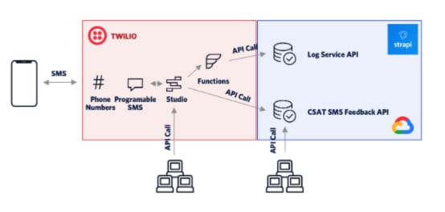

Slide 25
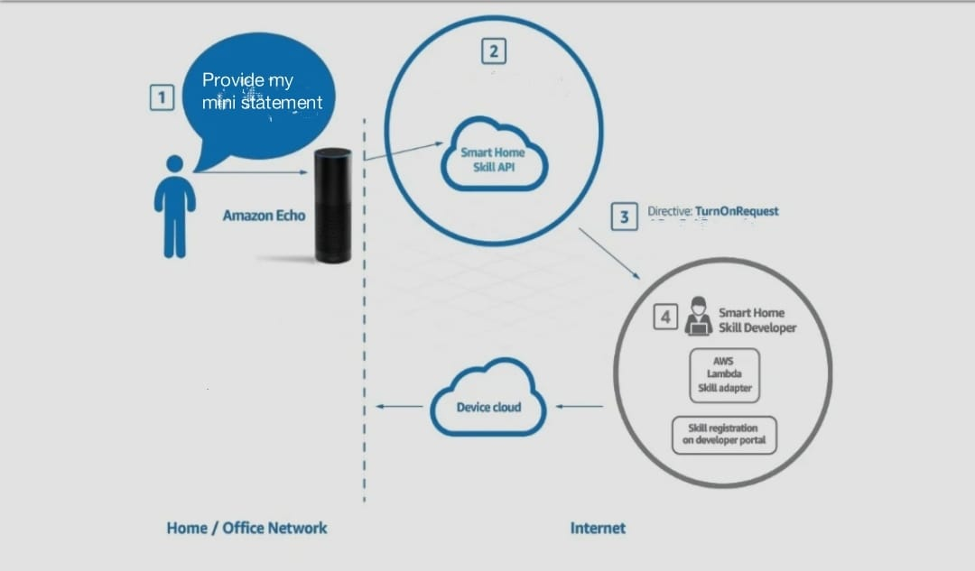

Slide 26
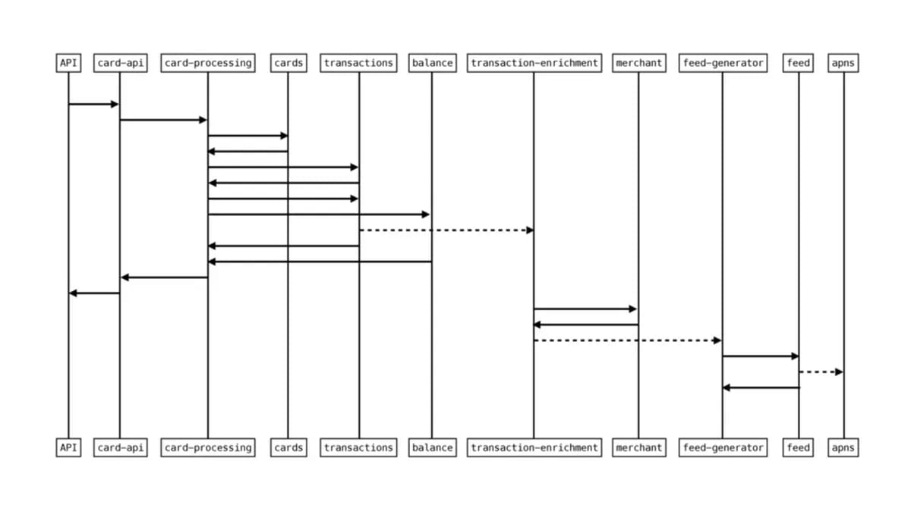

Slide 27
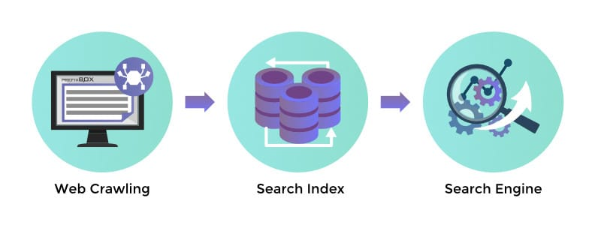

Slide 28
- Use IBM Watson (chatbot) - To create dialogue - store account data to cloud - use python (programming language)+ flask(web framework)+HTML(Hyper text markup language) to launch web preview

Slide 29
THANK YOU

